Slide 1
Programming with C Lecturer : Odile Nzambazamariya Lecture 1: Understand basic programming concepts with C Adventist University of Central Africa

Slide 2
Outlines
Introduction to computers
Types of programming languages
Introduction to C
Features of C
Applications of C
Compilers
Running C programs.

Slide 3
Introduction to computers
A computer is an electronic device (a tool) which accepts data or information in one form and processes it to produce data or information in another form
i.e. in a more meaningful manner.
It accepts data as its input, process data according to the predefined rules (programs) and produces results (output) in the form of data and/or actions.
It can convert data into information that is useful to people.
In other words a computer is a machine which collects, stores, retrieves, manipulates and displays information.

Slide 4
Introduction to computers
A computer is a fabulous instrument that turns human inputs into electronic information that it then can store or share/distribute through various output devices.

Slide 5
Introduction to computers
A complete computer system has four distinct parts:
Hardware
Software
Data
User

Slide 6
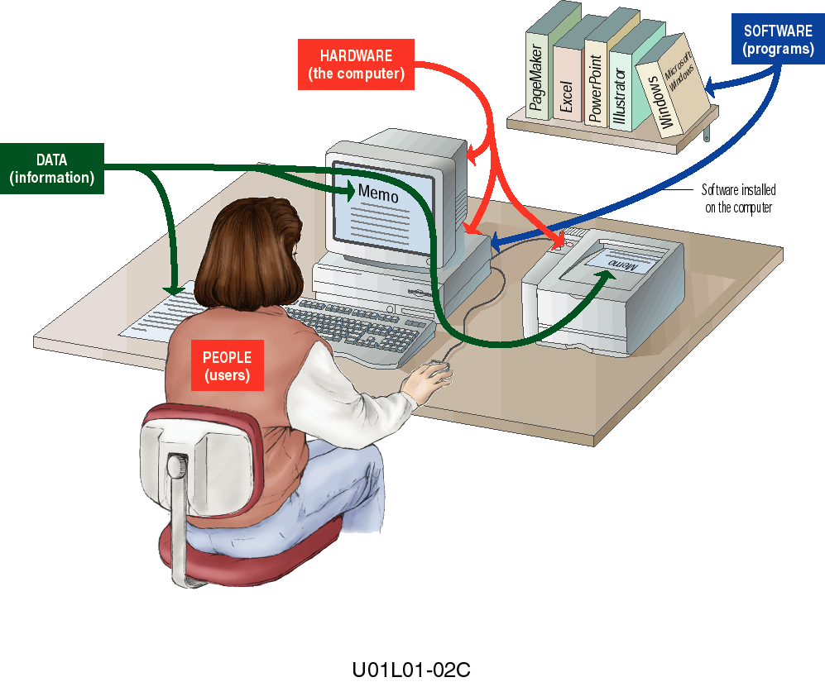
Introduction to computers

Slide 7
Introduction to computers
Hardware: refers to the physical components of a computer system that you can see and touch. Examples include the keyboard, mouse, monitor, CPU, memory, and printer.
Software: is a set of programs and instructions that tell the hardware what to do. Examples include the operating system, application programs, and programming languages like C.
Data: is the raw facts and figures that are processed by the computer to produce meaningful information. Examples include numbers, text, images, and symbols.
User: is the person who operates the computer system, provides input, and uses the output produced by the system.

Slide 8
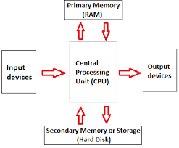
Functions of computer components
Input Devices: are used to enter data and instructions into the computer system. They allow the user to communicate with the computer by providing raw data that will be processed.
Central Processing Unit (CPU): is the main processing unit of the computer and is often called the brain of the system. It interprets and executes instructions, performs arithmetic and logical operations, and controls all activities of the computer.
Primary Memory(RAM): stores data and programs temporarily while the computer is in operation. It allows fast access to information needed by the CPU during processing.
Secondary Storage Devices: store data and programs permanently for future use. They retain information even when the computer is turned off.
Output Devices: display or produce the results of processed data. They present information to the user in a readable or usable form.

Slide 9
Functions of computer components
An operating system (OS): is a set of programs containing instructions that coordinate all the activities among computer hardware resources.
Functions of OS:
starting a computer
providing a user interface
managing programs
managing memory
scheduling jobs
configuring devices
establishing an internet connection, etc.

Slide 10
Programming languages
A programming language is a language used by humans to write instructions that tell a computer what to do. It allows programmers to communicate with a computer in a structured and understandable way, instead of using binary numbers (1s and 0s).

Slide 11
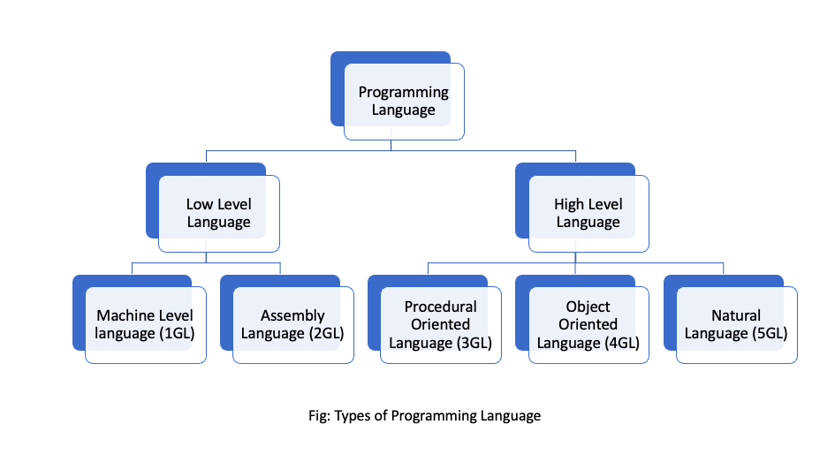
Types of programming languages

Slide 12
Types of programming languages
Low-Level Languages
Low-level languages are programming languages that are closer to the hardware. They provide little or no abstraction from the computer’s internal operations and are machine dependent.
a) Machine Level Language (1GL)
Machine language is the lowest-level programming language, written in binary code (0s and 1s). It is directly understood by the computer without translation, but it is very difficult for humans to read, write, and debug.
b) Assembly Language (2GL)
Assembly language uses mnemonic codes (such as ADD, MOV, SUB) instead of binary. It is easier to understand than machine language but still machine dependent and requires an assembler to convert it into machine code.

Slide 13
Types of programming languages
2. High-Level Languages
High-level languages are designed to be easy for humans to read, write, and understand. They are mostly machine independent and require a compiler or interpreter to translate them into machine language.
a) Procedural Oriented Language (3GL)
Procedural languages focus on procedures or functions that operate on data. Programs are written as a sequence of steps or instructions. Examples: C, Pascal, FORTRAN
b) Object Oriented Language (4GL)
Object-oriented languages organize programs around objects, which combine data and behavior. They support concepts such as encapsulation, inheritance, and polymorphism, making programs easier to manage and reuse. Examples: C++, Java, Python
c) Natural Language (5GL)
Natural languages allow programmers to give instructions in a form that is close to human language. They are mainly used in artificial intelligence and problem-solving systems, where the programmer specifies what needs to be done rather than how to do it. Examples: Prolog, AI-based languages

Slide 14
Programming Paradigms
Programming paradigm is an approach to solve problems using some programming language.
It is a method to solve a problem using tools and techniques that are available to us following some approach.
There are lots of programming languages that are known but all of them need to follow some strategy when they are implemented and this methodology/strategy is paradigms.
Apart from varieties of programming languages, there are lots of paradigms to fulfil each and every demand.

Slide 15
Programming Paradigms
There are many different programming paradigms. Some of them are:
Imperative programming: approach would be to write every single step to do the task.
Functional programming: we don’t specify the steps to do the task. Instead, we specify what we want to do.
Object-oriented programming: we create objects and we use those objects to do the task.
Logic programming: we specify the rules and facts. Then we ask the computer to find the solution.
Declarative programming: a programming style that focuses on what the program should do rather than how it should do it, emphasizing clarity and simplicity.

Slide 16
Introduction to C
C is a programming language developed at AT & T’s Bell Laboratories of USA in 1972. It was designed and written by a man named Dennis Ritchie. In the late seventies C began to replace the more familiar languages of that time like PL/I, ALGOL, etc.

Slide 17
Introduction to C
The C Language is a general purpose, high level and structured oriented programming language.
C programming features, where derived from an earlier language called ‘B’ (BCPL- Basic Combined Programming Language).
C language was invented for implementing UNIX operating system.
In 1978, Dennis Ritchie and Brian Kernighan published the first edition “ The C Programming Language” and commonly known as “K & R C” .

Slide 18
Features of C
Portability: Programs written in C language can be run on any compiler with little or no modifications of a program.
Flexibility: C language has number of reserved keywords, which helps the programmers to take control over the usage of language and to modify the structure of program.
Modularity: C language provides feature of modularity, i.e. we can breakdown a large program into manageable modules. This feature provides easy to understand and debugging of the program will become faster.

Slide 19
Features of C
Robustness: C language is a robust language, with rich set of built-in functions and operators that can be used to write any complex programs.
Extensibility: In C language program, the new features can be added at any time by the programmer to the existing program.
Efficiency and effectiveness: Programs written in C language are fast and efficient, due to the variety of data types and powerful operators.

Slide 20
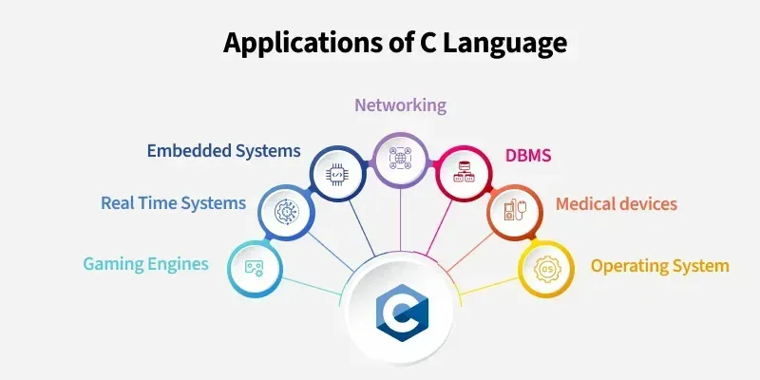

Slide 21
Applications of C Language
Operating Systems: C is used to develop operating systems because it provides direct control over hardware and efficient memory management.
Embedded Systems: C is widely used in embedded systems to program microcontrollers and hardware devices with limited memory and resources.
Real-Time Systems: C is suitable for real-time systems because it is fast and predictable, ensuring tasks are completed within fixed time limits.
Networking: C is used in networking to develop communication software, protocols, and network drivers.

Slide 22
Applications of C Language
Database Management Systems (DBMS): C is used in DBMS development for high performance and efficient data processing.
Gaming Engines: C is used in game engines to build performance-critical components such as graphics and physics engines.
Medical Devices: C is used in medical devices where reliability, accuracy, and hardware control are essential.

Slide 23
Compilers
Why do we need a Translator?
A computer program is written using a high-level language.
Only humans are capable to understand these languages and not machines.
Translator - converts a high-level language code to the binary language code which machines can understand.

Slide 24
Compilers
A compiler is a system software that translates an entire program written in a high-level language into machine-understandable code (binary code) at once. This translation is done before execution, and any errors are reported after the compilation process.

Slide 25
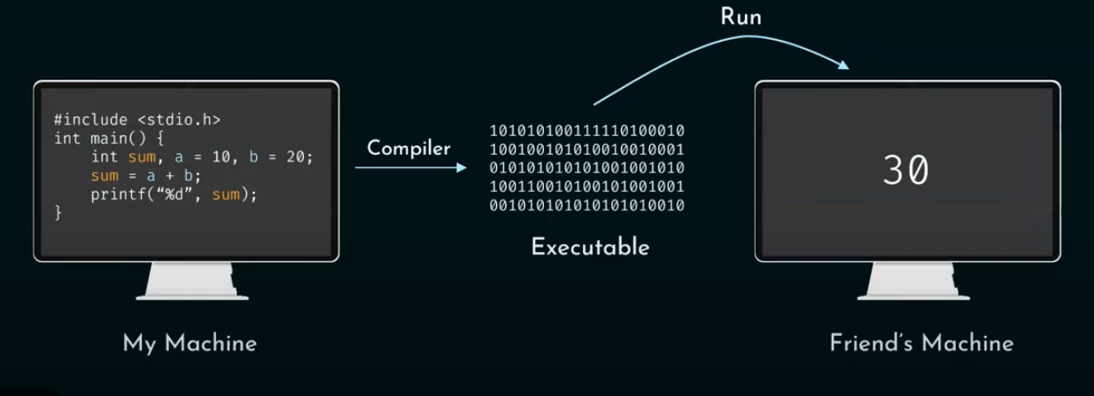
Compilers

Slide 26
IDE
Integrated Development Environment (IDE)
IDE is a software application that provides tools for writing, compiling, running, and debugging programs in one place, making software development easier and more efficient.

Slide 27
SOURCE CODE
Source code is the original set of instructions written by a programmer to create a computer program. It is written in a human-readable programming language and consists of elements such as functions, definitions, methods, and statements that tell the computer what to do.
Source code serves as the foundation of software and is later translated into machine-readable form for execution.

Slide 28
Running C programs
Structure of C Language program
Comment line
Pre-processor directive
Global variable declaration
main function( )
{
Local variables;
Statements;
}
User defined function
}
}

Slide 29
Running C programs
Comment line
It indicates the purpose of the program.
It is represented as /*……………………………..*/
Comment line is used for increasing the readability of the program. It is useful in explaining the program and generally used for documentation.

Slide 30
Running C programs
Pre-processor Directive:
#include<stdio.h> tells the compiler to include information about the standard input/output library. It is also used in symbolic constant such as #define PI 3.14(value).
The stdio.h (standard input output header file) contains definition &declaration of system defined function such as printf( ), scanf( ), pow( ) etc.
Generally printf() function used to display and scanf() function used to read value

Slide 31
Running C programs
Global Declaration:
This is the section of a program where variables are declared outside all functions, allowing them to be accessed by all functions in the program.
main() Function:
The main() function is the entry point of a C program, where program execution begins. It contains declarations and executable statements enclosed within curly braces { }.
The function may return a value (commonly int main() returning 0) or return no value using void main(). Each statement inside the function ends with a semicolon (;).

Slide 32
Running C programs
/*First c program with return statement*/
#include <stdio.h>
int main (void) {
printf (“Welcome to Programming with C.\n");
return 0;
}
Output: Welcome to Programming with C.

Slide 33
Steps for Compiling and Executing a C Program
Write the Source Program
The C program is written using a text editor.
The file is saved with a .c extension (e.g., prog1.c).
This file is called the source code.
Compile the Program
The compiler checks the source code for syntax and semantic errors.
Compilation is done using commands like: gcc prog1.c
Errors must be corrected before proceeding.

Slide 34
Steps for Compiling and Executing a C Program
Translate to Assembly Code
The compiler converts C statements into assembly language.
Generate Object Code
The assembler converts assembly code into object code (.o file).
Link the Program
Object code is linked with required libraries.
An executable file is created (a.out in Unix, .exe in Windows).

Slide 35
Steps for Compiling and Executing a C Program
Execute the Program
The executable file is run (e.g., ./a.out).
The program executes statements sequentially.
Debugging
If errors occur, the program logic is analyzed.
Corrections are made in the source code and recompiled.

